Slide 1

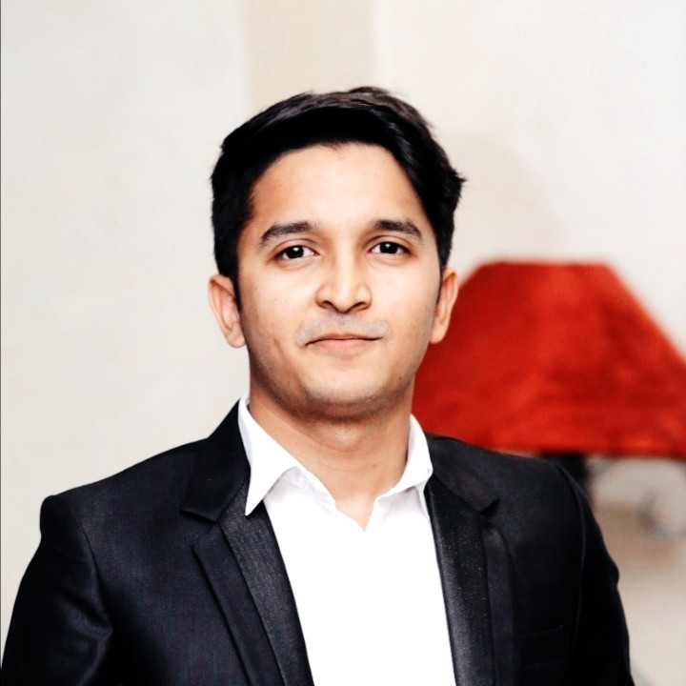
Syed Mouaaz Farrukh
linkedin.com/in/syed-mouaaz-farrukh/
Cloud Engineer @ Avanceon
Founder @ DevWithOps
Certified @ Azure –AWS

Slide 2
Day – 01: Cloud Odyssey
Cloud Essentials
Building a Foundation

Slide 3


What is
What is
Service Models:
(IaaS, SaaS, PaaS)
Cloud
Data Usage:
Storage to Analytics
Cloud Security:
Practices for Security
Network of Resources

Slide 4
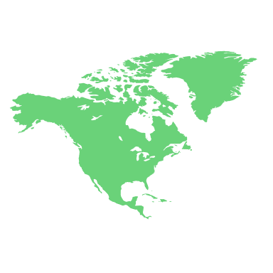
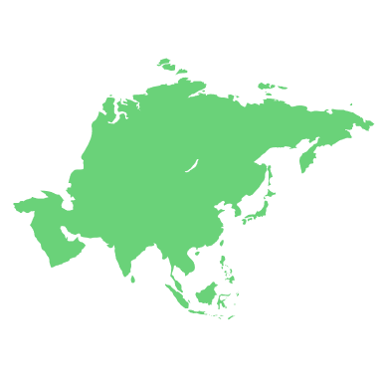






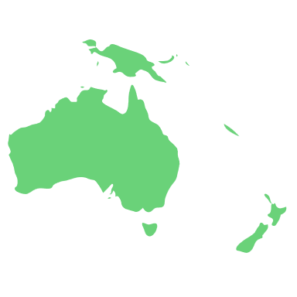
What is
What is
Service Models:
(IaaS, SaaS, PaaS)
Cloud
Data Usage:
Storage to Analytics
Cloud Security:
Practices for Security
Network of Resources

Slide 5

Why
Cloud
OpEx
CapEx

Slide 6


OpEx
CapEx
Scalability
Cost-Efficiency
Accessibility
Easy Maintenance
Backups/Recovery
Others
Ownership
Costly
Limited Accessibility
Difficult to Maintain
Sensitive Data

Slide 7




How
Virtual Playground
for Computers
Cloud
works
USERS
INTERNET
DATA CENTERS

Slide 8





Careers
SRE
Engineer
Cloud
Engineer
Cloud
Engineer
IoT Engineers
Educators/Trainers
Others
DevOps
Engineer
Data
Engineer

Slide 9
Learning Path
01
02
03
04
Theory
Labs
Use Case
Certification
Official Docs
Hands on Exercises:
KodeCloud
DevWithOPs
Real-World Programs
Data and IoT Solutions etc
Get Hired

Slide 10




Acquire Credits

Slide 11
AWS Credits
AWS Free Tier - https://aws.amazon.com/free
AWS EdStart - https://aws.amazon.com/education/awseducate/
AWS Imagine Grant Program - https://aws.amazon.com/government-education/nonprofits/aws-imagine-grant-program/
AWS Cloud Credits for Research - https://aws.amazon.com/government-education/research-and-technical-computing/cloud-credit-for-research/
AWS Educate - https://aws.amazon.com/education/awseducate/
AWS Webinar & Events - https://aws.amazon.com/events/
AWS Activate - https://aws.amazon.com/startups/credits#packages

Slide 12
Azure Credits
Azure for Students - https://azure.microsoft.com/en-us/free/students/
Azure Free Accounts - https://azure.microsoft.com/en-us/free/
Microsoft Partner Network - https://azure.microsoft.com/en-us/pricing/offers/ms-azr-0025p/
Microsoft for Startups - https://www.microsoft.com/en/startups
Microsoft for Nonprofits - https://www.microsoft.com/en-us/nonprofits/azure
Credits for Microsoft - https://events.microsoft.com/en-us/azure

Slide 13
GCP Credits
GCP Free Services - https://cloud.google.com/free/docs/free-cloud-features#free-tier
GCP Free Tier - https://cloud.google.com
GCP for Startups - https://cloud.google.com/startup
GCP for Trainers - https://cloud.google.com/edu/faculty
GCP for Education - https://support.google.com/google-cloud-higher-ed#topic=10322095

Slide 14



65$
Certification
Billion
32%
22%
11%

Slide 15
NEXT UP IN THE SERIES
Get started with
Cloud Solutions

Slide 16
THANK YOU

